Slide 2
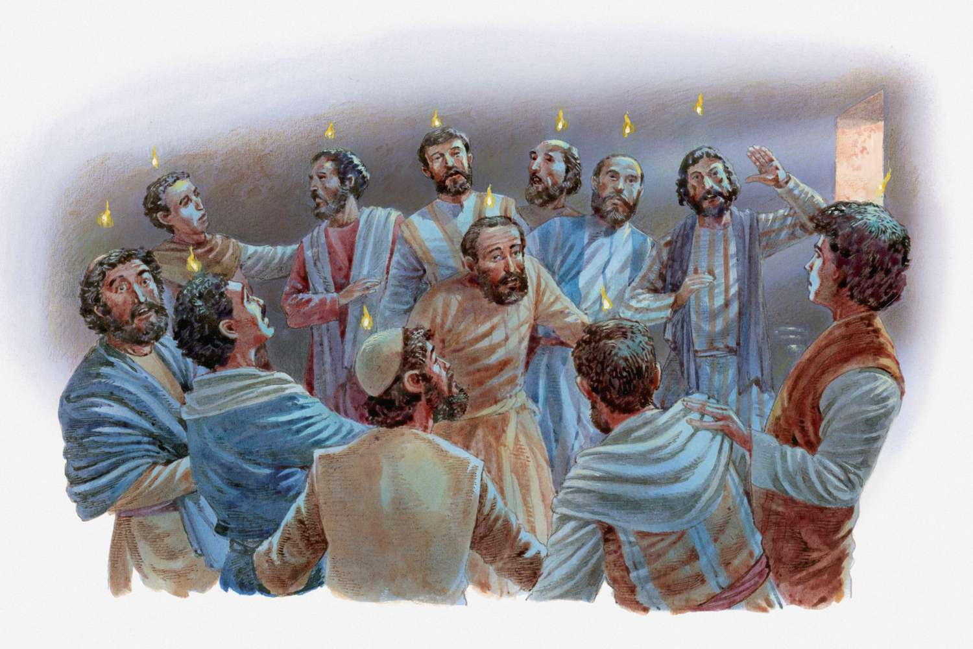
Why did only 3,000 obey the Gospel?

Slide 3
Why More People Today Who Hear The Gospel do NOT OBEY IT?
Christ DIED for ALL – Hebrews 2:9
Even for the UNGODLY – Romans 5:6
God does NOT wish you to PERISH – 2 Peter 3:9
God calls us by Gospel – 2 Thessalonians 2:14

Slide 4
WHY IS IT THAT THE MAJORITY OF PEOPLE IN THE WORLD REJECT GOD’S CALL THROUGH THE GOSPEL?
John 14:6 “no one comes to the Father except through Me.”
Matthew 7:13,14 “the gate and difficult {is} the way which leads to life, and there are few who find it."
1 John 5:19 “whole world lies {under the sway of} the wicked one."
Matthew 7:21-23 “`I never knew you; depart from Me, you who practice lawlessness!'"

Slide 5

Luke 8:5-10
A Lesson On WHY Only A Few Will Be Saved

Slide 6
Luke 8:5-10
A Lesson On WHY Only A Few Will Be Saved
Jesus CLEARLY taught that the MAJORITY WOULD NOT BE SAVED!
WHY?
Not because GOD DOES NOT LOVE THEM- John 3:16
The problem is within the HEART OF MAN!

Slide 7

THE FOUR HEARTS
Which Satan
Keeps
Which
Temptations
Gets
Overcome With
Cares, Pleasures,
And Riches
GOOD and
Honest

Slide 8
THE HEART WHICH SATAN KEEPS
Luke 8:5,12
The Devil is PRESENT each time the WORD is sown!
Many ways Satan steals the WORD out of a heart:
Lies and Deception- Genesis 3:4
Always Tomorrow – Acts 26:28
Life of SIN is really the best!
Think they are OKAY!
Don’t Let Him Steal The Word From Your HEART!

Slide 9
THE HEART WHICH TEMPTATION GETS
Luke 8:6,13
Obey the WORD with GREAT JOY!
1 Peter 5:8 “ your adversary the devil walks about like a roaring lion, seeking whom he may devour."
A Christian CAN FALL! Galatians 5:4; 2 Peter 2:20
Problem is NO ROOT – Ephesians 3:17; Colossians 2:7
James 1:14; 1 Thessalonians 5:22; 1 Peter 2:1,2

Slide 10
THE HEART OVERCOME WITH CARES, PLEASURES, and RICHES
Luke 8:7,14
CHOKED – Seized of Throttled, Suffocated, Drowned
CARES- includes worrying about ANYTHING!
Matthew 11:28-30 “I will give you rest”
RICHES – Possession or Seeking For Money/Things
1 Timothy 6:9,10 “love of money is a root of all {kinds of} evil”
Pleasures – things of WORLD before Love for God
James 4:1-7; Luke 9:62; 2 Timothy 4:6-8

Slide 11
THE HEART WHICH IS HONEST & GOOD
Luke 8:8,15
Prepared Heart – Will Make It To Heaven!
Honest – John 8:32; 17:17; Matthew 5:6
Good Heart – Pure and Holy – Matthew 5:8; 6:14,15
Hears The Word – Romans 10:17; James 1:19-21
Keeps The Word – James 1:21,22 “a DOER OF THE WORD”
Bring Forth Fruit – Galatians 5:22-25
Patient Heart – 1 Corinthians 15:58

Slide 12
THE MINORITY ARE MAKING IT TO HEAVEN
WHICH of the hearts we have looked at describes YOU?
Are YOU one who will make it?
IF NOT, WHY NOT?

